Slide 1
Project Management Process
DIV2 PMG Group

Slide 2
Table of Contents
01
Development Process
02
Related Documents
03
How to apply for Project

Slide 3
1. Development Process

Slide 4
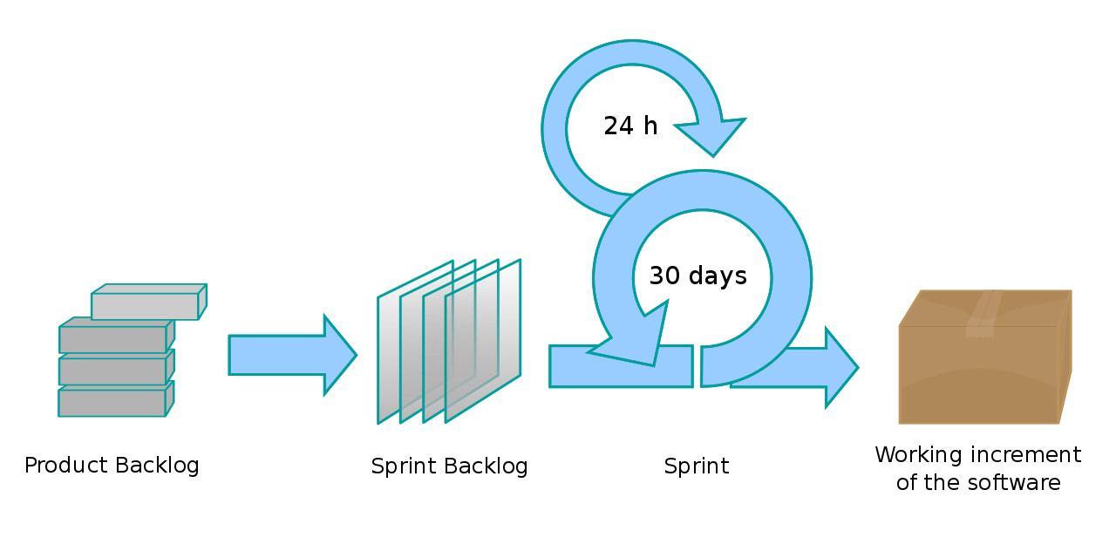
Project Management Process
Initiating
Planning
Closing
Monitoring

Slide 5
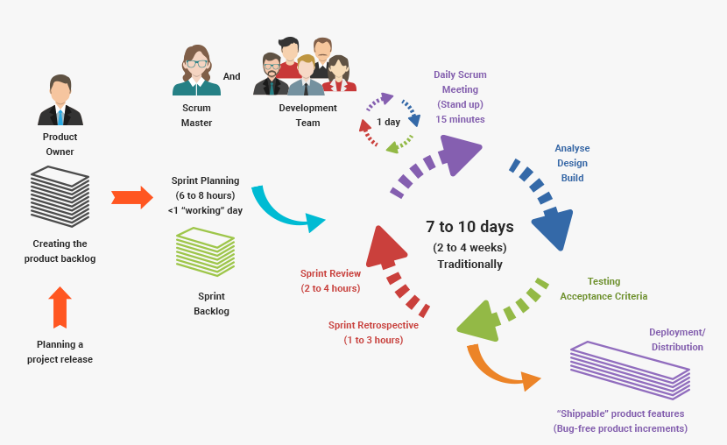
Scrum Framework

Slide 6
Scrum Roles
Product Owner | Scrum Master
Define the features of the product Decide on release date and content Be responsible for the profitability of the product (ROI) Prioritize features according to market value Adjust features and priority every iteration, as needed Accept or reject work results. | Represents management to the project Responsible for enacting Scrum values and practices Removes impediments Ensure that the team is fully functional and productive Enable close cooperation across all roles and functions Shield the team from external interference

Slide 7
Scrum Roles
Product Owner (PO): Customer, BrSE
Scrum Master (SM): GL, BrSE, TL
Scrum Team (ST):Team Leader, Dev, Comtor, QAer, Designer

Slide 8
2. Related Documents

Slide 9
[Initiating process]
Management Area | Action | Output | PIC | Template, guideline
Project Scope | - Define project overview & scope - Collect requirement & break function - Customer assumption & constraint - Estimate | Project Management: ・Estimation ・Master schedule Development ・Q&A Sheet | DM, GL | https://goo.gl/yBkHHZ https://goo.gl/F8xmG5

Slide 10
[Planning Process]
Management Area | Action | Output | PIC | Template, guideline
Project Overview | - Project deliverables - Technology - Scope | Project Management: ・Overview | PO (SM, ST) | https://goo.gl/nGwQJL
Communication Planning | - Communication policy | Project Management: ・Communication Policy | SM (PO, ST) | https://goo.gl/G5JAUY
Project organization | Define organization structure including: Teams: PO, SM, team stakeholders supporter | Project Management: ・Member list ・Org Chart | PO (SM) | https://goo.gl/8q1e7y

Slide 11
[Planning Process]
Management Area | Action | Output | PIC | Template, guideline
Project schedule (Function - task schedule) | Define the work that is required in order to produce the product or deliverables Estimate for each task | Project Management: ・WBS or some tool (jira, redmine, backlog) | PO (SM, ST) | https://goo.gl/MtKEhc
Project risk | - Define risk list, issues scenarios | Project Management: ・Risk Management | SM(PO, ST) | https://goo.gl/Yj5EhA
Project Environment and resources plan | - Infrastructure and cost - Test device - tools (dev, test tool) | Development: ・Infrastructure ・Account & Key | ST(SM) | https://goo.gl/TTYQDY

Slide 12
[Planning Process]
Management Area | Action | Output | PIC | Template, guideline
Product backlog (Function list) | ・Define Product backlog ・CR management | Development: ・Backlog Management ・CR Management | PO(SM, ST) | TODO
Working Process | Define below flow: How to create and do task How to deploy | Development: ・Task process ・Deploy rule | SM(PO, ST) | TODO

Slide 13
[Monitoring & Close Process]
Management Area | Action | Output | PIC | Template, guideline
Release Manual | Define release step | Development: ・Release Manual | PO, ST (SM) | https://goo.gl/AZnDzN
Project Checklist | Define some checklist & rule for develop smoothly and avoid bug | Development: ・Project Checklist | ST(PO, SM) | https://goo.gl/KqX8YC

Slide 14
3. How to apply for project

Slide 15
Template & Tools
Estimation & Master Schedule
WBS (Detail Schedule)
Project Management List
Release Manual
Project Checklist
Incident Report

Slide 16
Estimation & Master Schedule

Slide 17
1. Functions list, Estimation, Master schedule
Purpose: After receiving requirements from the client, (Product Owner) make estimation of effort and cost to complete the project requirements.
Functions list (user story)
Cost estimation
Stakeholder
Master schedule
Initial risks
→ Processes and templates used in before project starts phase
Functions list & Estimation
Master schedule
Objective:
Team leader (PM/Brse, Technical leader)
Developer

Slide 18
1. Functions list, Estimation, Master schedule
No | Field | Description | Action
1 | Analysis requirement | These abstruse point in requirement specification are clarified by making approach questions. * Use Q&A management template to manage | Analyze requirement Make Q&A to clear requirement
2 | Requirement confirmation | Meeting to confirm requirement specification
3 | Break functions | Create functions list follow requirement specification
4 | Technical issues | Figure out technical issue
6 | System requirements | These are version of operations that would developed
7 | Create estimation | Calculate cost of project
Start
Requirement specification document
Analysis requirement
Q&A management
Requirement
confirmation
Break functions
Technical issues
System requirements
Create estimation
Estimation document
End

Slide 19
1. Functions list, Estimation, Master schedule
Using man-hours to calculate cost of project
Start
No | Field | Description
1 | Formulation of structure | Specify appropriate formulation for coding, testing, technical-leader, communication effort
2 | Quotation instructions | Creating document based on original template.
3 | Calculation of effort | Technical leader or PIC specify cost for each function
4 | Review | Meeting to evaluate total effort
Formulation of structure
Quotation instructions
Calculation of effort
Review
Estimation document
End

Slide 20
1. Functions list, Estimation, Master schedule
Template: https://goo.gl/yBkHHZ
Notice:
Based on each project, the template can be modified ( ratio between unit test and coding, or management … ) to be appropriate.
The process must still be guaranteed to avoid unwanted problems, and easier to improve after project ends.

Slide 21
Project Management List
Project Overview
Project Communication Plan
Project Organization Chart
Project Member List
Project CM Rule

Slide 22
2. Project Management list
Purpose: After project is acquired, we will build development team and assure that project information is transfered clearly to and between all project members, towards the same goal.
What works need to be done?
How to organize project members? What is development environment?
What are templates to create project documents?
Make Detailed schedule
→ Processes and templates used in project starting phase
Objective :
PM/Brse

Slide 23
2. Project Management list
No | Field | Description
1 | Adjust/Organize | Define requirement information to prepare starting project, ex : outline, deliverables, schedule, resources, budget, issues, risk, etc...
2 | Material creation | Create necessary documents of project. * They will frequently updated in project development.
3 | Environment arrangement | Register account for team member: GIT, Redmine, Mail list
4 | Preparation | List all current devices and relevant operator system version
5 | Review | Write summary of information into Project Management sheet document.
6 | Kick off | Arrange meeting to sharing vision of project, also about information of project to team members. It is guaranty all members have same goal, and fulfill requirements of project.
Start
Project Book
Adjust/Organize
Material creation
Schedule
Enviroment
arangement
Redmine
Preparation
Git (SVN)
ML creation
Review
Kick off
End

Slide 24
2. Project Management list
Template : https://goo.gl/nGwQJL
Notice:
Based on each project, the template can be modified, but these information must be guaranteed:
Information of members.
Daily meeting format
Task, Report management tool

Slide 25
Detail Schedule

Slide 26
3. Detail schedule
Purpose: In each development phase (sprint), we must complete certain functions. Managing start, delivery time for each function is very important. There are many tools to do manage these (Redmine, JIRA)
→ Processes and templates used in before project starts phase
Objective:
Team leader (PM/Brse, Technical leader)
Developer

Slide 27
3. Detail schedule
No | Field | Description
1 | Create WBS | After estimated effort of project, team need to breakdown work to indicate milestone.
2 | Schedule creation | Make detail schedule based on WBS Each task has to specified start/due data and PIC. Beside time for coding/testing, we need to add buffer for effort of communication.
3 | Review / Assign | Assign task to developer by using redmine
4 | Review | Look back schedule to gurant that it is approved by PIC. Evaluate risk can expose in development progress. Technical issues. Dependent on design team.
Start
WBS
WBS document creation
Schedule creation
Schedule
Review / Assign
Review
End

Slide 28
3. Detail schedule
Template: https://goo.gl/MtKEhc
Notice:
Based on each project, the template can be modified to be appropriate, but it must be guaranteed so all functions (user story) in phase (sprint) are presented in the document, with corresponding start date, due date, status.

Slide 29
Release Procedure

Slide 30
4. Release Procedure
Purpose
Prepare related documents to release sprint or project on production environment.
Document
Document | Priorty | Template
Release Manual | required | https://goo.gl/AZnDzN
Project Checklist | required | https://goo.gl/KqX8YC
Risk Management | optional | Template: https://goo.gl/Yj5EhA Guideline: https://goo.gl/HNynF4

Slide 31
4.1. Release Procedure
No. | Step | Action
１ | Release preparation | ・Create release manual and get confirmation from customer ・Check and update release checklist ・Check Risk Management and get confirmation for release from customer
2 | Release execution | ・Perform step by step in release manual ・If a problem occur (error, delay, …), immediately notify people involved ・Perform rollback after confirm with customer
3 | Release finish | ・Confirm operation after release ・Perform hotfix if necessary
Release preparation
Release execution
Release finish

Slide 32
4.2. Release Manual
Include step by step to perform when release
Communication: Who to report? When to report?
Deploy step: Display maintainance page, deploy to where?, setting autoscale,...
If it is too complex with multiple lines of code, create a separate step by step file and have it reviewed carefully.
Test after release: This includes checking the operation state of system, execute test on production environment if necessary.

Slide 33
4.3. Project Checklist
Checklist based on incident and issue occurred in company projects
Checklist is updated in the development process.
Detail
Infra & Environment Buiding: Check and create checklist in preparation phase
Spec: References when creating spec
Developement: Mindset and rules the team must follow when starting project.
Release: checklist when release

Slide 34
5. Risk Management
Risk management incurred in project development
Risk need to be managed and monitored in project development
Risk list must be shared with the customer
When release, need to confirm with the customer, with the current existing risk list, can the project be released?

Slide 35
Incident Report

Slide 36
Overview
Incident is... What??
All issues occurred which directly affect the customer, for example: security, production bug affect system business, or problems which make release on time impossible.
Incident report... When?
Whenever an issue occurs, it must be reported.
Report to... Where?
Manager (TL, BrSE, GL, SM, DM)
Customer
Company via Google Form

Slide 37
Flow
PIC
Team or customer
BrSE, TL
Team
BrSE or TL
Detect issue
Report issue to manager & customer
Resolve issue
Report issue to Company Google Form

Slide 38
Framgia Incident Report Form
https://docs.google.com/forms/d/e/1FAIpQLSd6bX-Fh_W1TOBM_2m9MOrz3DNkUNfIdWMsCkjJIVwI9el0Cg/viewform

Slide 39
Thank you for listening m(_ _)m

